Slide 1

A QPUF-Based Scheme for Secure and Adaptable Quantum Device Attestation in NISQ Devices
Franco Cirillo and Christian Esposito
University of Salerno
fracirillo@unisa.it
International Conference on Quantum Communications, Networking, and Computing (QCNC 2025)

Slide 2
Introduction
Quantum computing marks a new technological frontier with profound implications for computation
Need for reliable and secure quantum device attestation mechanisms has become a critical concern
Quantum devices participating in computations or data exchanges are genuine, uncompromised, and authorized.
A QPUF-Based Scheme for Secure and Adaptable Quantum Device Attestation in NISQ Devices – Franco Cirillo– fracirillo@unisa.it
Notes:
Quantum computing marks a new technological frontier for the computation
As quantum computing systems evolve, the need for reliable and secure device attestation mechanisms has become a critical concern.
Attestation ensures that quantum devices participating in computations or data exchanges are genuine, uncompromised, and authorized.

Slide 3

Introduction
Scenario: Clients request computational tasks to quantum service providers
They must be assured that the device executing their requested computations matches the one specified
A quantum service provider could potentially substitute the requested high-performance quantum device with a cheaper, less capable system.
A QPUF-Based Scheme for Secure and Adaptable Quantum Device Attestation in NISQ Devices – Franco Cirillo– fracirillo@unisa.it
Notes:
This is particularly important in scenarios where clients request computational tasks to quantum service providers,
as they must be assured that the device executing their requested computations matches the one specified or agreed upon.
Without robust attestation mechanisms, a quantum service provider could potentially substitute the requested high-performance quantum device with a cheaper, less capable system.

Slide 4

Challenges
Traditional attestation methods rely on securely storing cryptographic keys or certificates
Quantum computers are characterized by their underlying physical implementations, which vary significantly across providers
Difficulty of developing a universal attestation mechanism capable of reliably verifying devices from heterogeneous providers.
A QPUF-Based Scheme for Secure and Adaptable Quantum Device Attestation in NISQ Devices – Franco Cirillo– fracirillo@unisa.it
Notes:
Traditional attestation methods face significant limitations in the quantum domain due to their reliance on securely storing cryptographic keys or certificates. (Ensuring the secure transfer and storage of keys can be complex and error-prone)
Therefore, Unlike classical systems, quantum computers are characterized by their underlying physical implementations, which vary significantly across providers and platforms.
This diversity in hardware architecture accentuates the difficulty of developing a universal attestation mechanism capable of reliably verifying devices from heterogeneous providers.

Slide 5
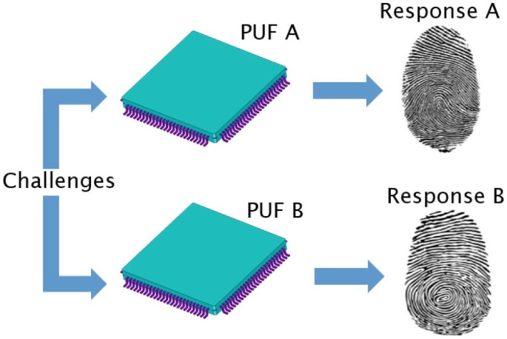
Quantum Physical Unclonable Functions (QPUFs)
Quantum Physical Unclonable Functions (QPUFs) offer a promising solution for quantum device attestation by exploiting the inherent errors and imperfections of NISQ devices.
Using the Challenge-Response paradigm, a challenge is presented to the quantum device, and the device generates a response based on its unique quantum errors.
This response can then be used to attestate the device and verify its integrity within a secure system.
A QPUF-Based Scheme for Secure and Adaptable Quantum Device Attestation in NISQ Devices – Franco Cirillo– fracirillo@unisa.it
Notes:
In this context, Quantum Physical Unclonable Functions (QPUFs) offer a promising solution for quantum device attestation by exploiting the inherent errors and imperfections of NISQ devices.
%%These quantum errors and imperfections are harnessed to generate unique and unpredictable responses tied to the specific characteristics of the quantum hardware.
Using the Challenge-Response paradigm, a challenge is presented to the quantum device, and the device generates a response based on its unique quantum errors. This response can then be used to authenticate the device and verify its integrity within a secure system.

Slide 6
State of the Art: Limitations and Challenges
Many studies are purely theoretical, without proposing practical methods or concrete implementations.
Some works rely on quantum memory and quantum channels, which are not yet fully developed or readily accessible.
Only a few studies are tested on real quantum devices
A QPUF-Based Scheme for Secure and Adaptable Quantum Device Attestation in NISQ Devices – Franco Cirillo– fracirillo@unisa.it
Notes:
The State of the Art there presents some Limitations and Challenges

Slide 7
Objective
The goal is also to create a simple system that does not require additional hardware.
Design of a quantum circuit that functions as a QPUF, capable of extracting the unique characteristics of a quantum device.
Evaluation on real IBM hardware based on critical metrics such as uniqueness, instability, and randomness.
Attestation scheme based on the QPUF's challenge-response paradigm and the use of an attestation service.
Key Contribution
A QPUF-Based Scheme for Secure and Adaptable Quantum Device Attestation in NISQ Devices – Franco Cirillo– fracirillo@unisa.it
Notes:
We design a quantum circuit that functions as a QPUF, capable of extracting the unique characteristics of a quantum device. The circuit is evaluated on real IBM hardware based on critical metrics such as uniqueness, instability, and randomness to demonstrate its effectiveness in generating robust challenge-response pairs.
We develop an attestation scheme based on the QPUF's challenge-response paradigm and the use of an attestation service. This scheme leverages the unique properties of quantum devices to perform secure attestation, not needing any quantum memory.
We discuss about parameter optimization and security consideration to enhance the reliability of the method.

Slide 8
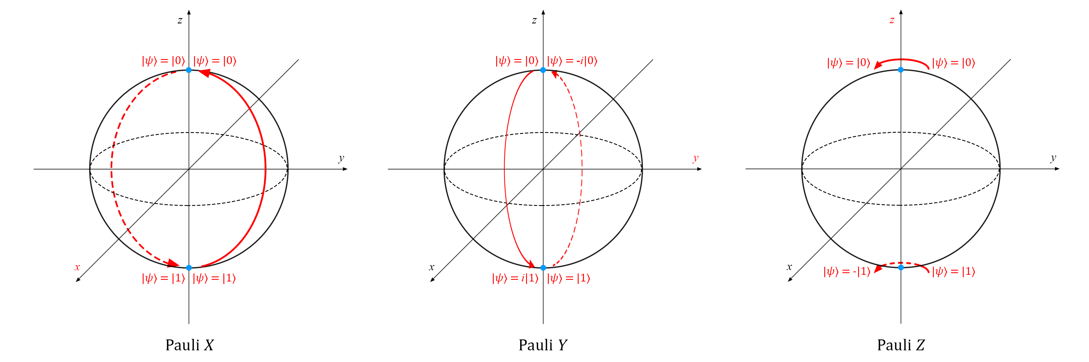
Proposed QPUF
The proposed QPUF circuit leverages the inherent biasing of qubits towards the 1 or 0 state. This biasing can arise from single and two gate errors, including those associated with X-Y-Z rotation gates, or from readout errors.
A QPUF-Based Scheme for Secure and Adaptable Quantum Device Attestation in NISQ Devices – Franco Cirillo– fracirillo@unisa.it

Slide 9
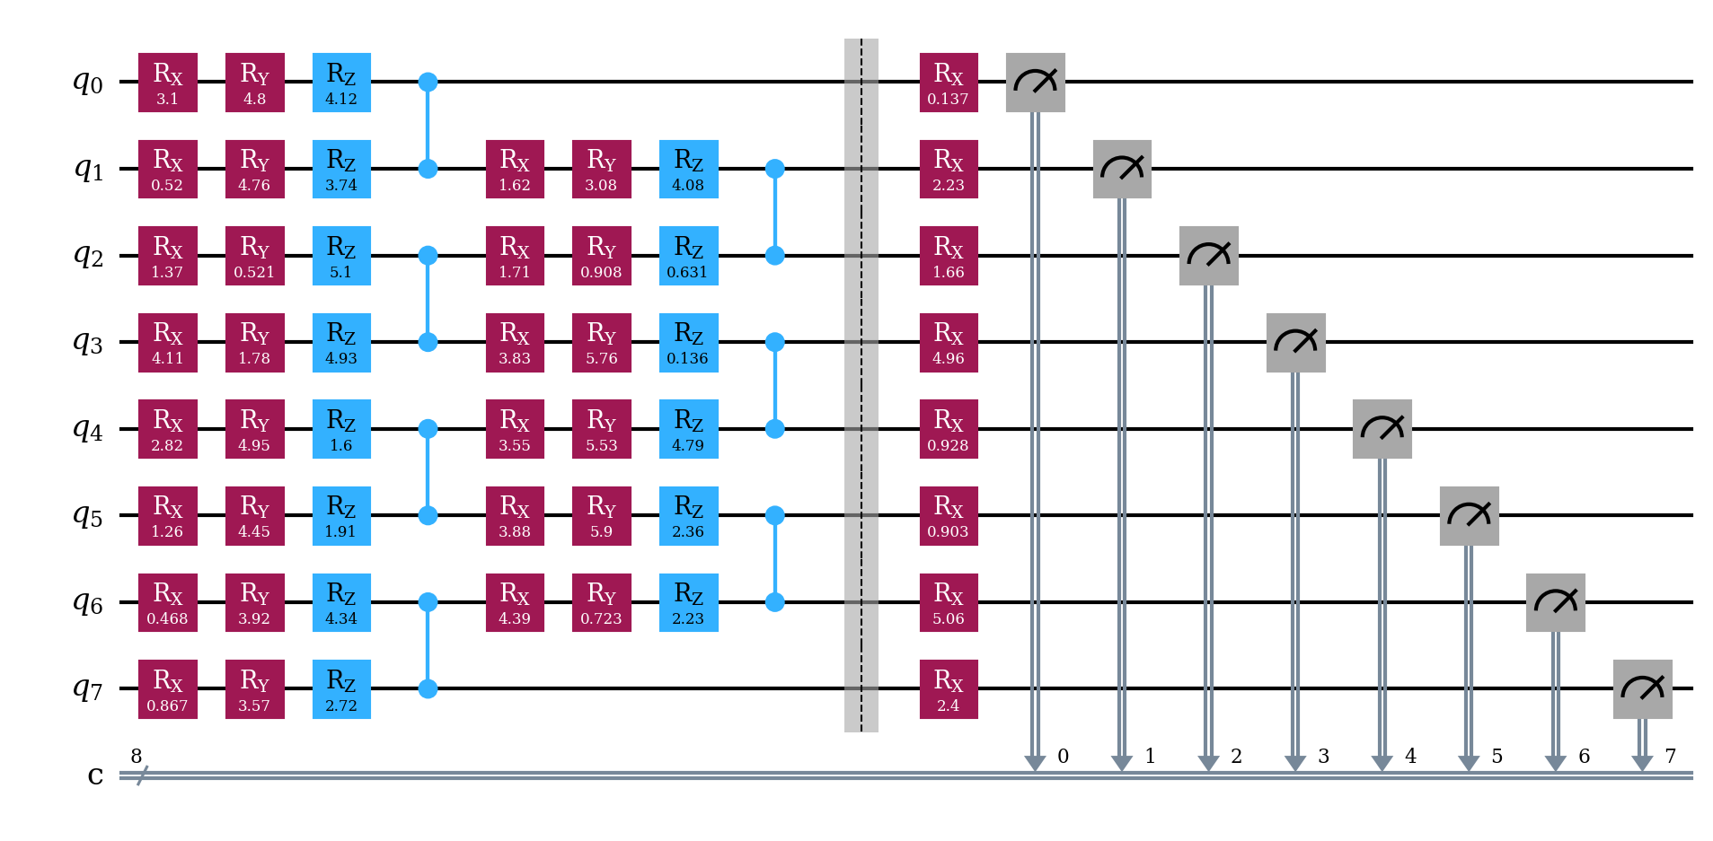
Proposed QPUF
A QPUF-Based Scheme for Secure and Adaptable Quantum Device Attestation in NISQ Devices – Franco Cirillo– fracirillo@unisa.it
Notes:
The Figure shows an instance of the proposed QPUF circuit, based on 8 qubits and with random gates angles.
%Initially, each qubit is initialized to the zero state.
Subsequently, each qubit undergoes sequential rotations in every plane using X-Y-Z rotation gates, with angles parameterized within the range from 0 to (2 pie). Next, each qubit is entangled with its predecessor or successor using Controlled-Z gates. These two steps are iterated once more to ensure entanglement across all qubits and an other X rotation is applied to every qubits, to exploit the entanglement. Finally, all qubits are subjected to measurement.

Slide 10
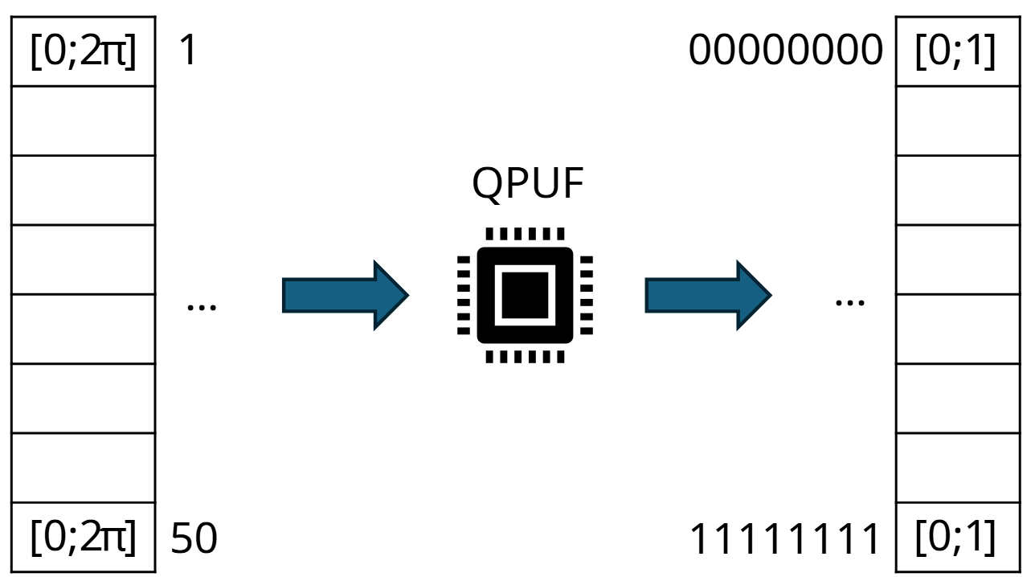
Proposed QPUF
Challenges appear as arrays including all parameters for every individual gate within a single instance.
Each respective response constitutes the outcome of measuring all qubits following the execution of the circuit a specific number of times.
A QPUF-Based Scheme for Secure and Adaptable Quantum Device Attestation in NISQ Devices – Franco Cirillo– fracirillo@unisa.it
Notes:
For instance, within an 8-qubit circuit as depicted in Figure, a challenge is delineated by 50 angles, with values falling within the range 0 2pie
…
In practical terms, the response corresponds to a dictionary wherein each potential combination of qubit values is associated with its corresponding output percentage between 0 and 1, and where all values of a single response sum to 1.

Slide 11
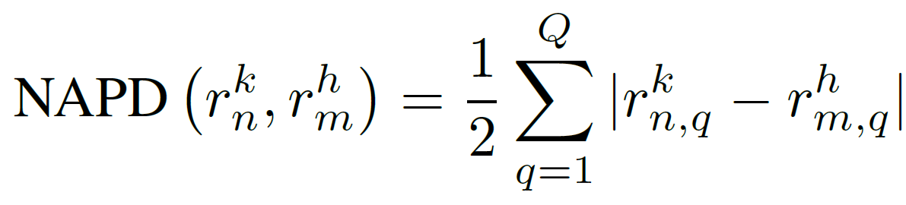
QPUF metrics
Instability refers to variations and unpredictability in the QPUF responses of a single device.
We compared QPUF responses by means of a Normalized Absolute Probabilistic Distance (NAPD) over every response pair.
r^{k}_{n,q} ->
q-th combination of qubit results on Q=2^{nqubits}
n-th challenge
k-th device
A QPUF-Based Scheme for Secure and Adaptable Quantum Device Attestation in NISQ Devices – Franco Cirillo– fracirillo@unisa.it
Notes:
To assess the quality of the proposed QPUF system, several metrics have been tested:
In order to evaluate such Instability,

Slide 12
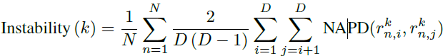
QPUF metrics
Instability for the k-th device can be estimated as follows:
r^{k}_{n,i} ->
For each challenge and for each distinct pair of executions on the same challenge, NAPD is computed.
i-th output of D executions
n-th challenge out of N
k-th device
A QPUF-Based Scheme for Secure and Adaptable Quantum Device Attestation in NISQ Devices – Franco Cirillo– fracirillo@unisa.it
Notes:
To calculate the instability,

Slide 13
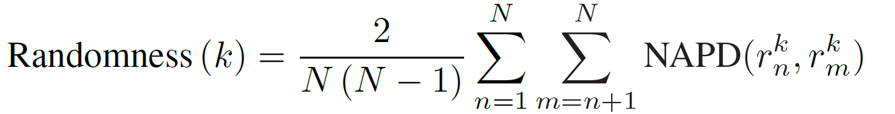
QPUF metrics
Randomness ensures that each response is maximally distinct from another, even when presented with similar challenges.
The Randomness for the k-th device can be estimated as follows:
r^{k}_{n} ->
For each distinct pair of challenges, NAPD is computed.
n-th challenge out of N
k-th device
A QPUF-Based Scheme for Secure and Adaptable Quantum Device Attestation in NISQ Devices – Franco Cirillo– fracirillo@unisa.it

Slide 14
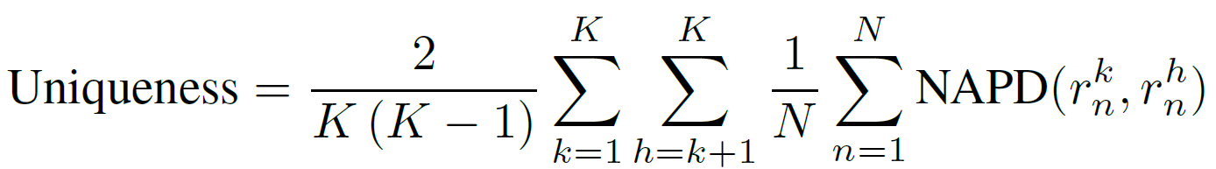
QPUF metrics
Uniqueness denote that each generated output from every single device is distinct from outputs of all other devices, giving the same input.
The Uniqueness can be estimated as follows:
r^{k}_{n} ->
For each distinct pair of devices and for each challenge, NAPD is computed.
n-th challenge out of N
k-th device out of K
A QPUF-Based Scheme for Secure and Adaptable Quantum Device Attestation in NISQ Devices – Franco Cirillo– fracirillo@unisa.it

Slide 15
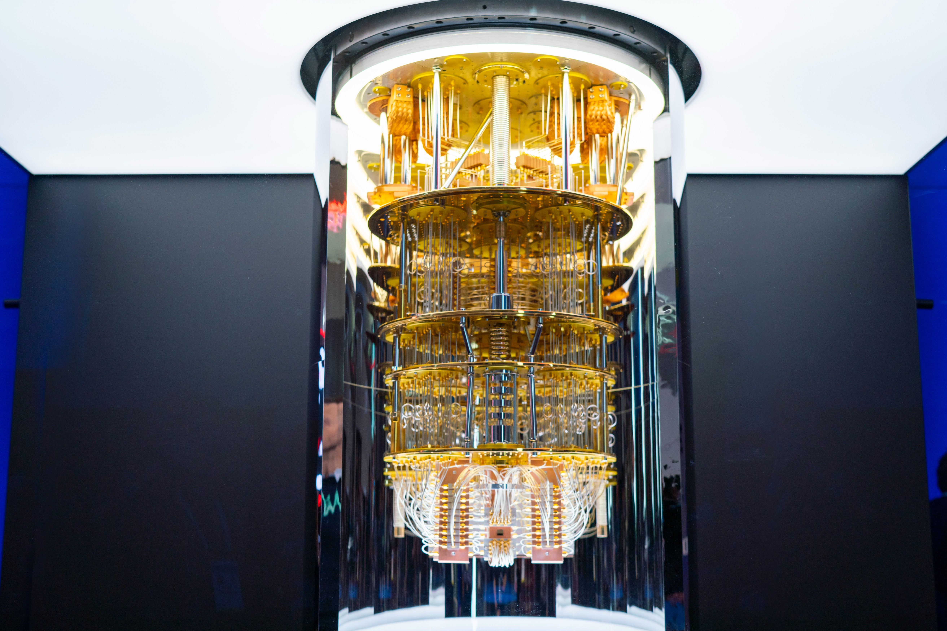
Experimental results
Real quantum hardware provided by IBM, namely ibm_brisbane, ibm_sherbrooke, and ibm_kyiv, has been employed, leveraging the Qiskit SDK.
In general, the QPUF circuit described has been employed with a qubit count of 8 and a measurement shot count of 20,000 per circuit.
A QPUF-Based Scheme for Secure and Adaptable Quantum Device Attestation in NISQ Devices – Franco Cirillo– fracirillo@unisa.it
Notes:
In conducting experiments to evaluate QPUFs quality,

Slide 16
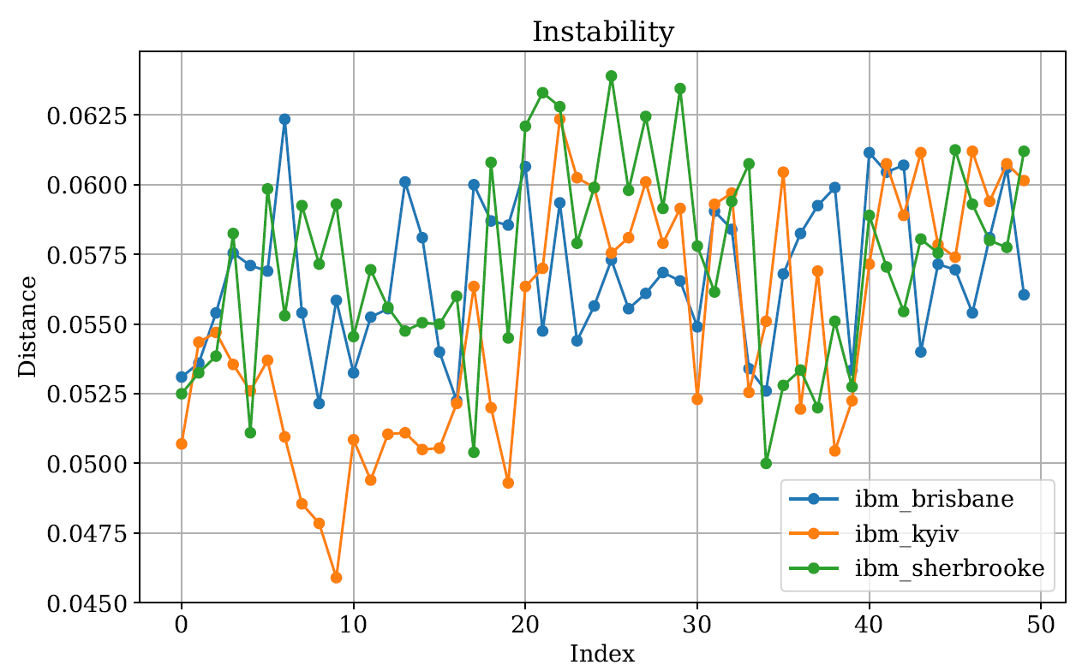
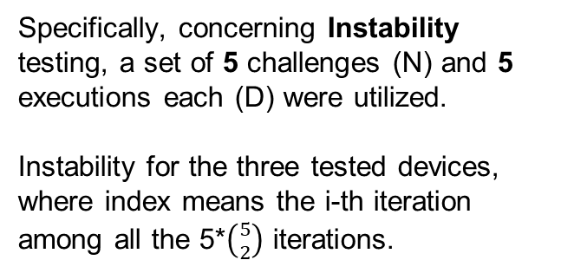
Experimental results
Specifically, concerning Instability testing, a set of 5 challenges (N) and 5 executions each (D) were utilized.
Instability for the three tested devices, where index means the i-th iteration among all the 5*$\left({5 \atop 2}\right)$ iterations.
A QPUF-Based Scheme for Secure and Adaptable Quantum Device Attestation in NISQ Devices – Franco Cirillo– fracirillo@unisa.it
Notes:
For Instability testing, a set of 5 challenges ($N=5$) and 5 executions per challenge ($D=5$) were used.
Figure \ref{fig:instability} shows the distribution of Instability for the three tested devices, where index means the i-th iteration among $5*\binom{5}{2}$ iterations.
From the graphs, it can be observed that Instability values across all three devices hover around 5\%, with a maximum value not exceeding 7\%.
Additionally, increasing the number of measurement shots or executions leads to a reduction in Instability. This indicates that, without constraints on the usage of quantum hardware, the results can be further improved.

Slide 17
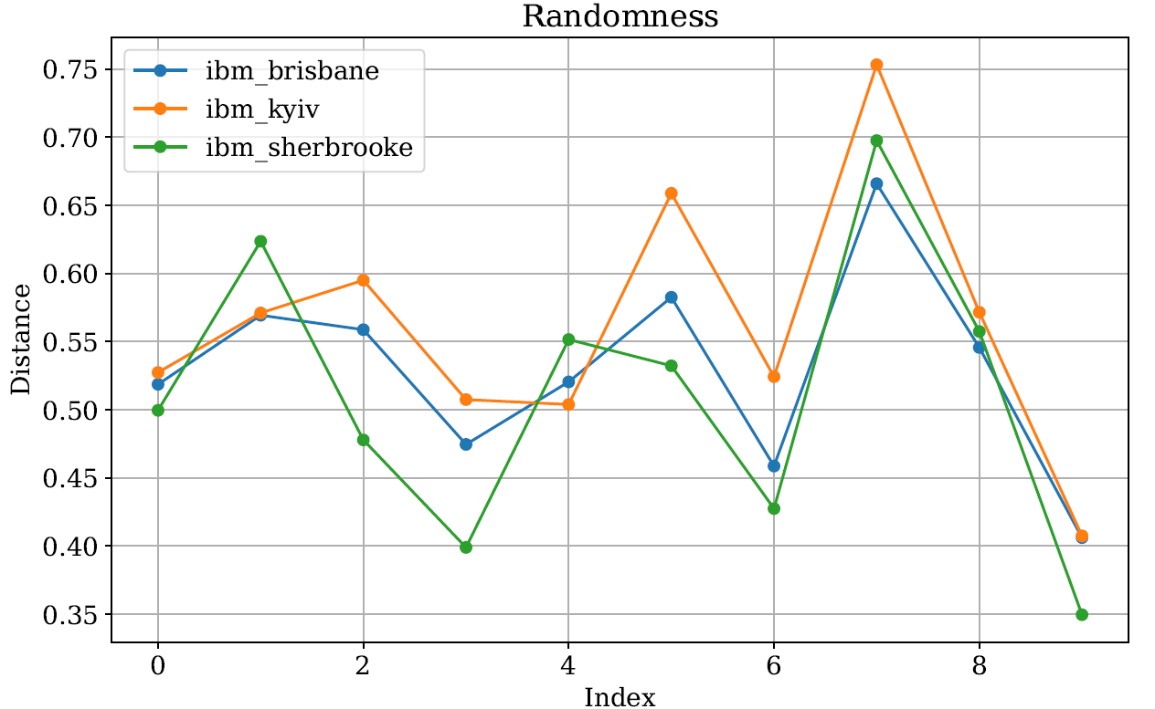
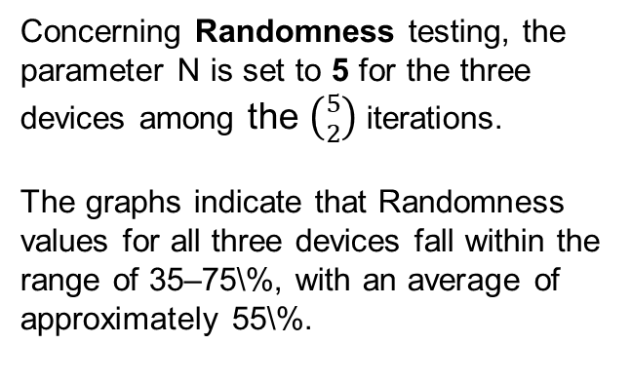
Experimental results
Concerning Randomness testing, the parameter N is set to 5 for the three devices among the $\left({5 \atop 2}\right)$ iterations.
The graphs indicate that Randomness values for all three devices fall within the range of 35–75\%, with an average of approximately 55\%.
A QPUF-Based Scheme for Secure and Adaptable Quantum Device Attestation in NISQ Devices – Franco Cirillo– fracirillo@unisa.it
Notes:
For Randomness testing, the number of challenges was set to $N=5$. Figure \ref{fig:randomness} illustrates the distribution of Randomness for the three devices among $\binom{5}{2}$ iterations. The graphs indicate that Randomness values for all three devices fall within the range of 35–75\%, with an average of approximately 55\%.

Slide 18
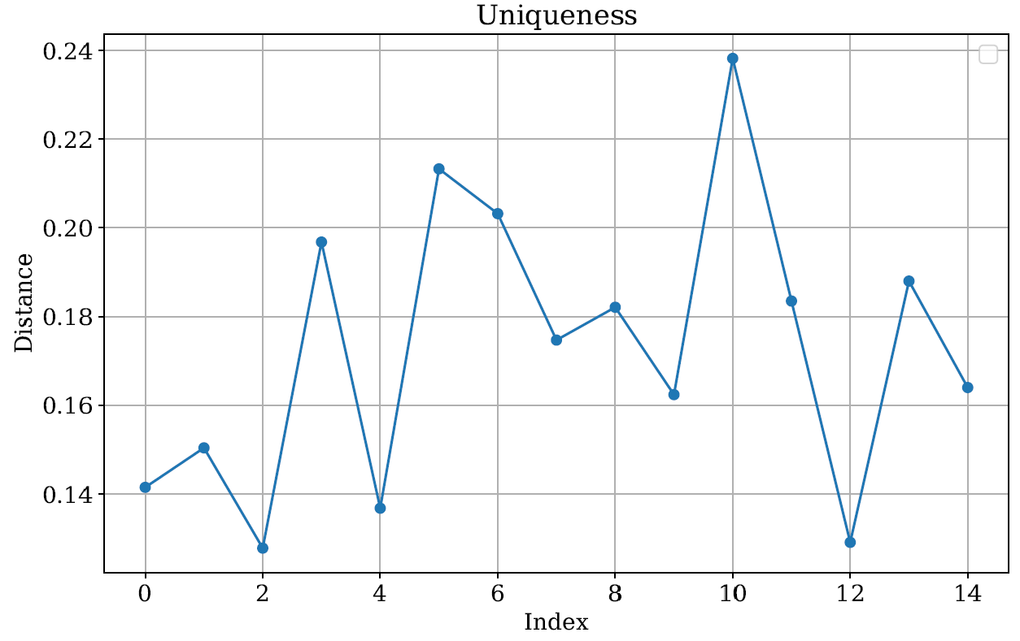
Experimental results
Concerning Uniqueness testing, the parameter N is set to 5 and K is 3 for the three IBM devices used.
From the graphs, it can be observed that the Uniqueness values range between 15–25\%, not going below 12\%.
A QPUF-Based Scheme for Secure and Adaptable Quantum Device Attestation in NISQ Devices – Franco Cirillo– fracirillo@unisa.it
Notes:
For Uniqueness testing, the number of challenges was set to $N=5$, and the number of devices was $K=3$. Figure \ref{fig:uniqueness} shows the distribution of Uniqueness across the three tested devices for $3*5$ iterations. From the graphs, it can be observed that the Uniqueness values range between 15–25\%, not going below 12\%.

Slide 19
Discussion of the results
Instability values serve as an upper bound, given the continuous improvement observed by increasing the number of executions of the quantum circuit.
The achieved results aimed at obtaining acceptable values rather than aiming for the best possible outcomes, primarily due to limitations in utilizing the quantum computing service.
Uniqueness of devices can be further enhanced by employing the attestation scheme described subsequently.
A QPUF-Based Scheme for Secure and Adaptable Quantum Device Attestation in NISQ Devices – Franco Cirillo– fracirillo@unisa.it
Notes:
To interpret the obtained results, it is essential to note that the derived Instability values represent an upper bound, as continuous improvement was observed with an increased number of quantum circuit executions. The results aimed at achieving acceptable performance, rather than optimizing for the best possible outcomes, primarily due to limitations in the use of the quantum computing service.
Overall, the metric graphs indicate low Instability, good Randomness and a satisfactory Uniqueness. However, the Uniqueness of devices can be further enhanced by employing the attestation scheme described subsequently.

Slide 20



Device attestation scheme
The framework involves three main actors:
Quantum Provider (supplies quantum computing services),
Client (uses the services),
Attestation Service (manages device registration, monitoring, and attestation).
It operates in two phases: Enrollment and Attestation.
A QPUF-Based Scheme for Secure and Adaptable Quantum Device Attestation in NISQ Devices – Franco Cirillo– fracirillo@unisa.it
Notes:
The framework involves three main actors: the Quantum Provider (supplies quantum computing services), the Client (uses the services), and the Attestation Service (manages device registration, monitoring, and attestation). It operates in two phases: Enrollment and Attestation.

Slide 21
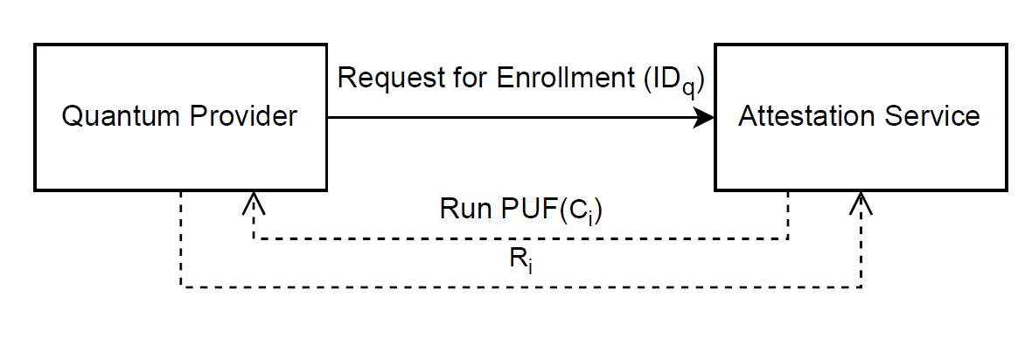
Device attestation scheme
Enrollment
Quantum Provider initiates a request to the Attestation Service to register a specific quantum device by sending its identifier.
The Attestation Service send a series of N random challenges to test the device's unique Quantum PUF.
The Provider executes the required circuits with these challenges and returns the corresponding responses, which are saved as CRPs.
A QPUF-Based Scheme for Secure and Adaptable Quantum Device Attestation in NISQ Devices – Franco Cirillo– fracirillo@unisa.it
Notes:
During the Enrollment phase, in Figure, the Quantum Provider initiates a request to the Attestation Service to register a specific quantum device by sending its identifier. The Attestation Service generates a series of $N$ random challenges to test the device's unique Quantum PUF.
The Provider executes the required circuits with these challenges and returns the corresponding responses, which are saved as CRPs. To prevent the Provider from caching or precomputing responses, the Attestation Service introduces randomness in the timing of these requests, spreading them over unpredictable intervals. This ensures the Provider cannot identify enrollment-related requests or store a large set of precomputed responses, making the process secure and infeasible to manipulate.
The unique Quantum PUF responses are securely stored for future verification in the Attestation phase.

Slide 22
Device attestation scheme
Enrollment
To prevent the Provider from caching or precomputing responses, the Attestation Service introduces randomness in the timing of these requests, spreading them over unpredictable intervals.
This ensures the Provider cannot identify enrollment-related requests or store a large set of precomputed responses, making the process secure and infeasible to manipulate.
A QPUF-Based Scheme for Secure and Adaptable Quantum Device Attestation in NISQ Devices – Franco Cirillo– fracirillo@unisa.it
Notes:
During the Enrollment phase, in Figure, the Quantum Provider initiates a request to the Attestation Service to register a specific quantum device by sending its identifier. The Attestation Service generates a series of $N$ random challenges to test the device's unique Quantum PUF.
The Provider executes the required circuits with these challenges and returns the corresponding responses, which are saved as CRPs. To prevent the Provider from caching or precomputing responses, the Attestation Service introduces randomness in the timing of these requests, spreading them over unpredictable intervals. This ensures the Provider cannot identify enrollment-related requests or store a large set of precomputed responses, making the process secure and infeasible to manipulate.
The unique Quantum PUF responses are securely stored for future verification in the Attestation phase.

Slide 23
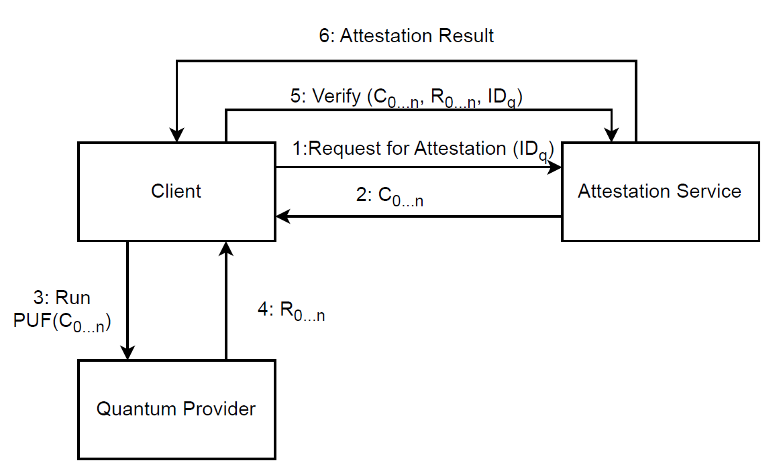
Device attestation scheme
Attestation
Client requests attestation for a specific quantum device, sending the identifier of the quantum computer.
The Attestation Service responds by selecting n random challenges not already used for previous attestations.
The Client then sends these challenges to the Quantum Provider, which executes them on the claimed quantum device and returns the corresponding n responses.
A QPUF-Based Scheme for Secure and Adaptable Quantum Device Attestation in NISQ Devices – Franco Cirillo– fracirillo@unisa.it
Notes:
In the Attestation Phase, the goal is to verify that the requested quantum computations are being executed on the authentic quantum device, enrolled with the Attestation Service.
The process begins when the Client requests attestation for a specific quantum device, sending the identifier of the quantum computer. The Attestation Service responds by selecting $n$ random challenges not already used for previous attestations. The Client then sends these challenges to the Quantum Provider, which executes them on the claimed quantum device and returns the corresponding $n$ responses. The Client forwards these responses, along with the original challenges and the identifier of the quantum computer, to the Attestation Service. The Attestation Service compares the received responses to the baseline responses generated during the enrollment phase. It calculates the average distance between the observed responses and the expected responses stored during enrollment. If this average distance is below a predefined threshold, $\lambda$, the attestation is deemed successful, confirming that the computations were executed on the authentic quantum device.

Slide 24
Device attestation scheme
Attestation
Client forwards these responses, along with the original challenges and the identifier of the quantum computer, to the Attestation Service.
The Attestation Service calculates the average distance between the observed responses and the responses stored during enrollment.
If this average distance is below a predefined threshold λ, the attestation is deemed successful.
A QPUF-Based Scheme for Secure and Adaptable Quantum Device Attestation in NISQ Devices – Franco Cirillo– fracirillo@unisa.it
Notes:
In the Attestation Phase, the goal is to verify that the requested quantum computations are being executed on the authentic quantum device, enrolled with the Attestation Service.
The process begins when the Client requests attestation for a specific quantum device, sending the identifier of the quantum computer. The Attestation Service responds by selecting $n$ random challenges not already used for previous attestations. The Client then sends these challenges to the Quantum Provider, which executes them on the claimed quantum device and returns the corresponding $n$ responses. The Client forwards these responses, along with the original challenges and the identifier of the quantum computer, to the Attestation Service. The Attestation Service compares the received responses to the baseline responses generated during the enrollment phase. It calculates the average distance between the observed responses and the expected responses stored during enrollment. If this average distance is below a predefined threshold, $\lambda$, the attestation is deemed successful, confirming that the computations were executed on the authentic quantum device.

Slide 25
Device attestation scheme
The threshold λ is set to 0.09, as the maximum Instability is 0.07 and the minimum Uniqueness is 0.12, in order to minimize false positives and false negatives.
The schema ensures security by preventing the Quantum Provider from substituting stored responses for requested challenges during the attestation phase.
The randomization of the challenge execution during enrollment makes it infeasible for the Provider to cache results.
A QPUF-Based Scheme for Secure and Adaptable Quantum Device Attestation in NISQ Devices – Franco Cirillo– fracirillo@unisa.it
Notes:
In our evaluation, The threshold λ is set to 0.09, as the maximum Instability is 0.07 and the minimum Uniqueness is 0.12, in-depth minimize false positives and false negatives. However, this can be further lowered by conducting a more in-depth analysis.
The schema ensures security by preventing the Quantum Provider from substituting stored responses for requested challenges during the attestation phase.
Because, The randomization of the challenge execution during enrollment makes it infeasible for the Provider to accurately precompute or cache results.

Slide 26
Conclusion
This study introduces a QPUF-based approach for quantum device attestation, ensuring adaptability across different quantum technologies.
Experiments on IBM’s quantum hardware assessed instability, randomness, and uniqueness, validating the method’s feasibility.
Tests were restricted to three devices, highlighting the need for future research across multiple quantum platforms to evaluate scalability and robustness.
Integration with ZKP.
A QPUF-Based Scheme for Secure and Adaptable Quantum Device Attestation in NISQ Devices – Franco Cirillo– fracirillo@unisa.it
Notes:
This study introduces a QPUF-based approach for quantum device attestation, eliminating the need for quantum memory and ensuring adaptability across different quantum technologies.
Experiments on IBM’s quantum hardware assessed instability, randomness, and uniqueness, validating the method’s feasibility.
However, due to resource limitations, tests were restricted to three devices, highlighting the need for future research across multiple quantum platforms to evaluate scalability and robustness.

Slide 27
Franco Cirillo and Christian Esposito
A QPUF-Based Scheme for Secure and Adaptable
Quantum Device Attestation in NISQ Devices
Contact: fracirillo@unisa.it

